Slide 1
Introduction
Objective: To develop a foundational understanding of management, organization and engineering management
6 Hours

Slide 2
1.1 Management
Management is the process of designing and maintaining an environment in which individuals, working together in groups, efficiently accomplish selected aims.
This designing and basic definition needs to be expanded:
As managers, people carry out the managerial functions of planning, organizing staffing, leading, and controlling.
Management applies to any kind of organization.
It applies to managers at all organizational levels.
The aim of all managers is the same: to create a surplus. (Profit)
Managing is concerned with productivity, which implies effectiveness and efficiency.

Slide 3
Management is the process of designing a controlled environment by planning activities and events, organizing, staffing, and leading a group of individuals to accomplish selected aims and goals while increasing productivity, efficiency and surplus in the process (Swostika)

Slide 4
1.1.1 Functions of Management
Five managerial functions—planning, organizing, staffing, leading, and controlling—around which the knowledge that underlies those functions can be organized.
These functions are affected by external factors such as political, economic, social, technological, ethical, legal
There are internal factors of strength and weakness that affects management functions
Management is an essential for any organization or enterprise

Slide 5
1.1.1 Functions of Management
Input Resources
Management Process
Output Objectives
Feedback

Slide 6
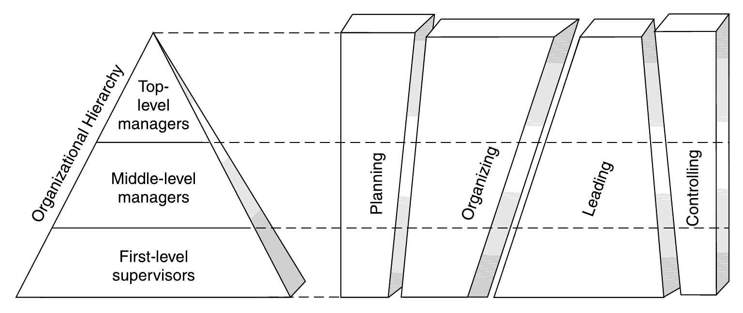
1.1.2 Level and scope of management
Time Spent in Carrying out Managerial Functions

Slide 7
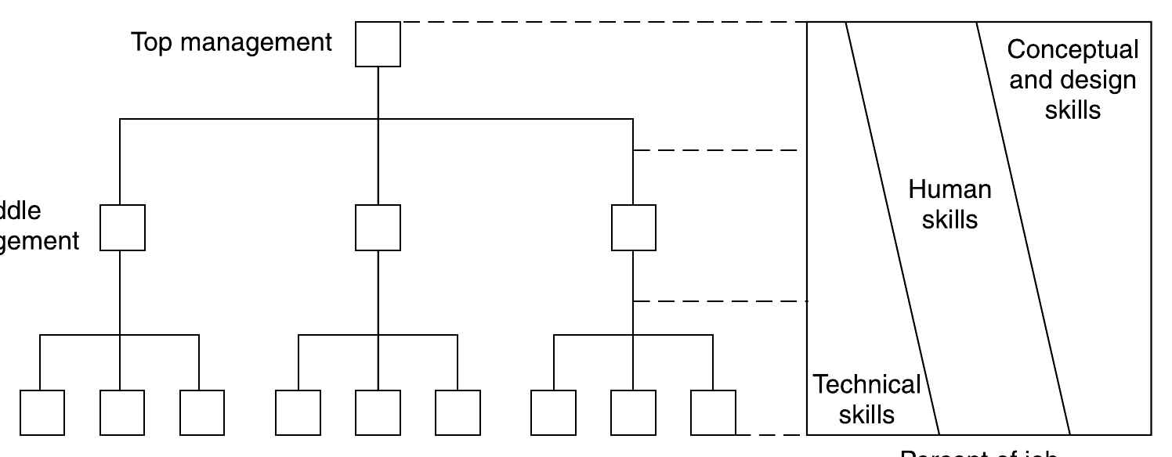
1.1.2 Level and scope of management
Skills and Managerial Levels
Middle level
Low level

Slide 8
1.1.3 Principles of Management
Fundamentals truth of general guidelines with universal acceptance
Principles are evolving so manger’s need is to become adaptive
Some of the key principles are:
Management by Objectives
Division of work
Substitution of resources
Span of control
Unity of functions
Unity of command
Delegation of authority
Management by exception
Shortest Decision path

Slide 9
Evolution of Management Thought
Learning Objectives:
Understand how management theories developed over time
Identify major contributors and their impact
Connect historical theories to modern engineering management practices

Slide 10
Classical Management Theories
1. Scientific Management
2. Modern Operational Management Theory
3. Behavioral Sciences Approach
4. Systems Theory
5. Modern Management Thinkers

Slide 11
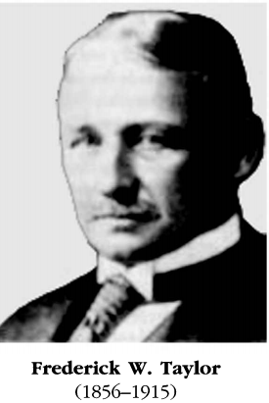
Scientific Management
Frederick W. Taylor
Father of Scientific Management
Works: Shop Management (1903), Principles of Scientific Management (1911)
Focused on efficiency, productivity, and incentive-based pay
Henry L. Gantt:
Developed Gantt Chart
Emphasized worker selection, cooperation, and training
Frank & Lillian Gilbreth:
Time-and-motion studies
Lillian focused on psychology and human factors
Key Principles:
Efficiency through standardization
Clear division of labor
Scientific approach to management decisions

Slide 12
Modern Operational Management Theory
Henri Fayol:
Father of modern management theory
Work: Administration Industrielle et Générale (1916)
Identified 6 groups of industrial activities
Proposed 14 principles of management
Technical
Commercial
Financial
Security
Accounting
Managerial

Slide 13
No. | Principle | Brief Description
1 | Division of Work | Specialization boosts efficiency and productivity.
2 | Authority | Right to give orders with accountability for outcomes.
3 | Discipline | Adherence to rules and respect for agreements.
4 | Unity of Command | Each worker should have only one direct supervisor.
5 | Unity of Direction | One leader, one plan for activities with the same objective.
6 | Subordination of Interest | Organization’s interests take precedence over individual interests.
7 | Remuneration | Fair and satisfactory payment for work performed.

Slide 14
No | Principle | Brief Description
8 | Centralization | Balance authority between top and lower levels of the organization.
9 | Scalar Chain | Clear line of authority from top to bottom (hierarchy).
10 | Order | Right people and materials in right place at right time.
11 | Equity | Fairness, kindness, and justice in treatment of employees.
12 | Stability of Tenure | Long-term employment promotes efficiency and loyalty.
13 | Initiative | Encourage employees to take initiative and contribute ideas.
14 | Esprit de Corps | Foster morale, harmony, and team spirit among staff.

Slide 15
Behavioral Sciences Approach
Chester Barnard:
The Functions of the Executive (1938)
Emphasized communication and cooperation
Max Weber:
Developed theory of bureaucracy
Vilfredo Pareto:
Pareto Principle; sociological contributions
Hugo Münsterberg:
Applied psychology to industry and management
Walter Dill Scott:
Applied psychology to advertising and personnel
Elton Mayo & F. J. Roethlisberger:
Hawthorne Studies: Social relationships influence performance

Slide 16
Systems Theory Approach
Management as a cooperative system
Emphasizes relationships among subsystems
Focus on organization as a whole
Supports social systems approach to managing

Slide 17
Modern Management Thinkers
William Ouchi (1981):
Theory Z (Japanese-American hybrid)
Peters & Waterman (1982):
In Search of Excellence
Characteristics of successful companies
Peter Drucker (1974):
Decentralization, innovation, effectiveness
W. Edwards Deming:
Quality control, continuous improvement
Laurence Peter (1969):
Peter Principle (incompetence at highest position)

Slide 18
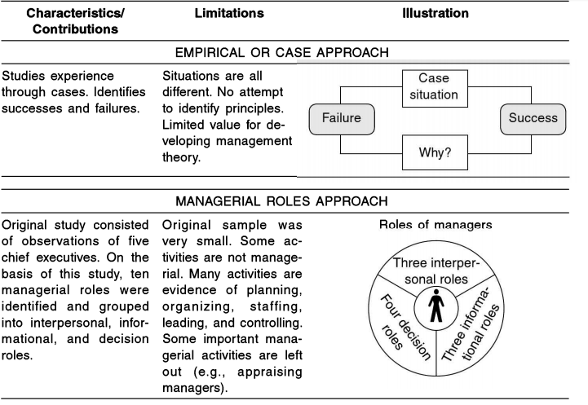

Slide 19
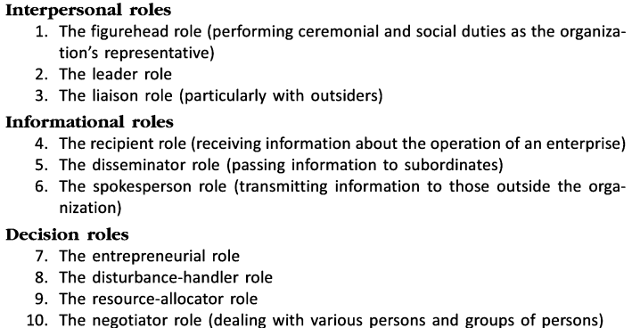

Slide 20
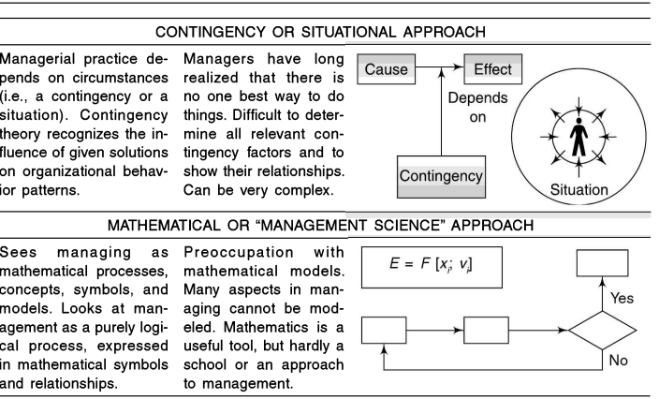

Slide 21
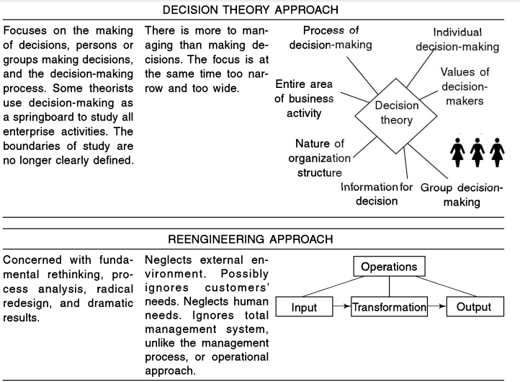

Slide 22
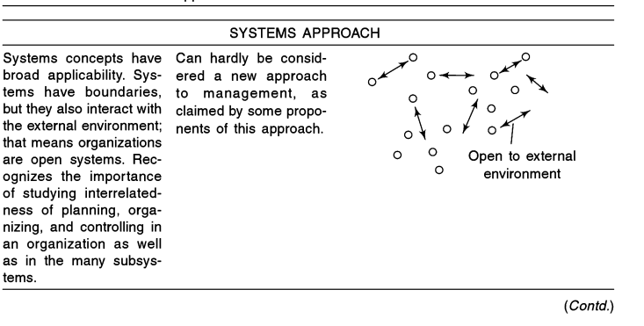

Slide 23
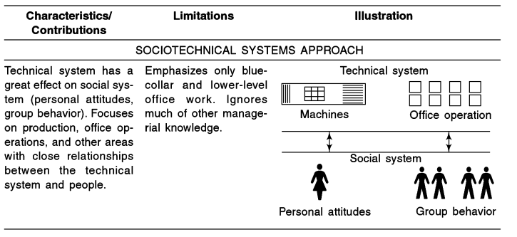

Slide 24
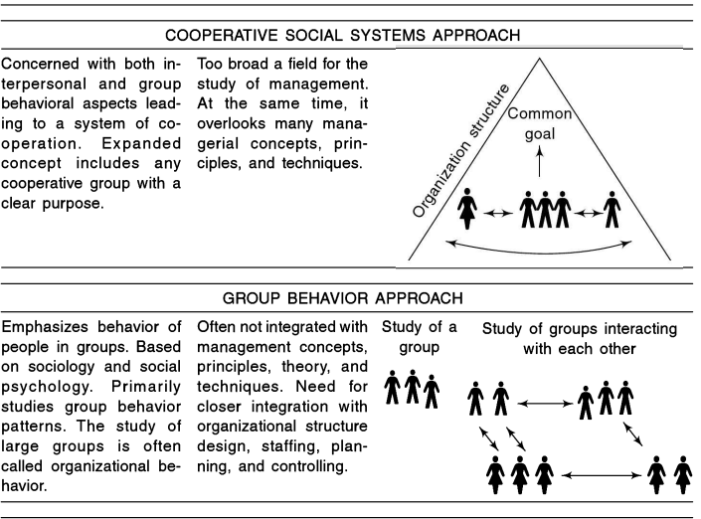

Slide 25
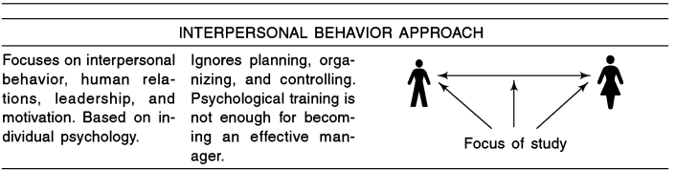
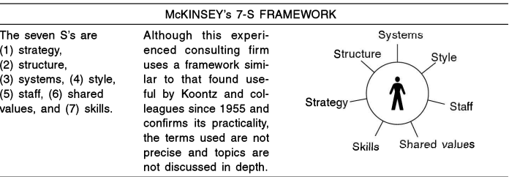

Slide 26
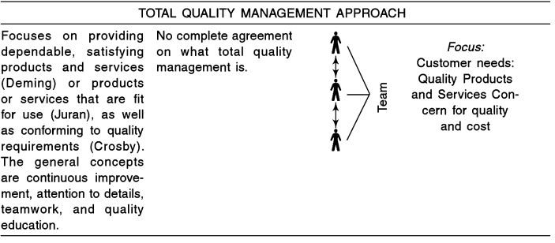

Slide 27
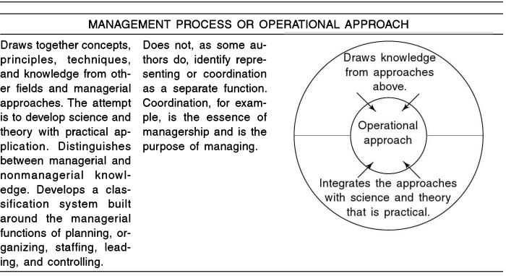

Slide 28
1.2 Organization
Organization is a localized intentional structure of roles or problems
The result of organizing is organization
Organizing involves:
the identification and classification of required activities
the grouping of activities necessary for attaining objectives
the assignment of each group to a manager with the authority (delegation) necessary to supervise it
the provision for coordination horizontally (on the same or a similar organizational level) and vertically (e.g., between corporate headquarters, division, and department) in the organization structure

Slide 29
Principles of organizing
Clarity about objectives
Division of work
Unity of command
Scalar chain
Span of control
Departmentation
Decentralization
Separation of line and staff functions
Authority and Responsibility
Simplicity
Flexibility

Slide 30
1.2.1 Characteristics of Organization
Distinct Purpose
Deliberate Structure
People
Source: Robbins

Slide 31
Eight characteristics of excellent enterprises
were oriented toward action
learned about the needs of their customers
promoted managerial autonomy and entrepreneurship
achieved productivity by paying close attention to the needs of their people
were driven by a company philosophy often based on the values of their leaders
focused on the business they knew best
had a simple organization structure with a lean staff
were centralized as well as decentralized, depending on appropriateness

Slide 32
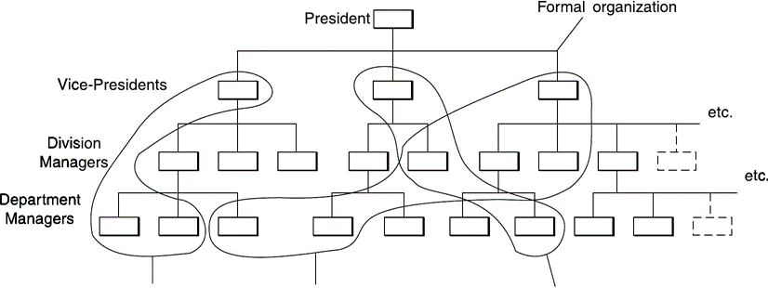
1.2.2 Types of organization: formal and informal organizations, virtual organization

Slide 33
Informal Organization
The informal organization is a network of interpersonal relationships that arise when people associate with each other
Thus, informal organizations relationships not appearing on an organization chart might include:
the machine shop group,
the sixth floor crowd,
the Friday evening bowling gang,
the morning coffee “regulars

Slide 34
Virtual Organization
Also called network organizations
Essence of these kinds of organization is to outsource managers business functions
Highly centralized
Practically no departmentalization
These organizations create a network of relationships that allow them to contract out almost all managerial functions, distribution, marketing, account-keeping, staff management and other functions

Slide 35
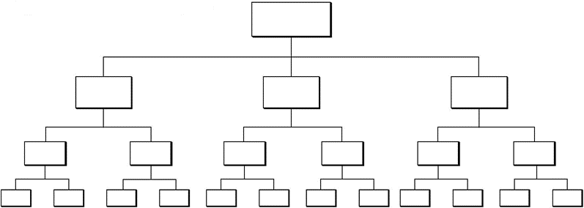
Organization with Narrow span
Advantages
Close supervision
Close control
Fast communication between subordinates and superiors
Disadvantages
Superiors tend to get too involved in subordinates' work
Many levels of management
High costs due to many levels
Excessive distance between lowest level and top level

Slide 36
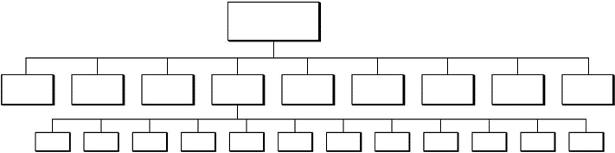
Organization with wide span
Advantages
Superiors are forced to delegate Clear policies must be made
Subordinates must be carefully selected
Disadvantages
Tendency of overloaded superiors to become decision bottlenecks
Danger of superiors loss of control
Requires exceptional quality of managers

Slide 37
Engineering Management and its importance in technology driven environment
Aspect | Importance
Innovation & R&D | Helps in managing innovation pipelines, promoting product development, and sustaining competitive advantage.
Strategic Planning | Aligns technological capabilities with business strategies in fast-changing markets.
Efficient Resource Use | Optimizes time, talent, and budget in complex, high-tech environments.
Cross-Disciplinary Coordination | Integrates efforts of engineers, designers, marketers, and operations teams for unified execution.

Slide 38
Engineering Management and its importance in technology driven environment
Aspect | Importance
Change Management | Supports smooth adoption of new technologies and digital transformation initiatives.
Risk Management | Identifies and mitigates technical, operational, and market risks in tech projects.
Quality & Compliance | Ensures systems meet performance standards, safety norms, and regulatory requirements.
Leadership in Tech Teams | Develops engineering talent, fosters collaboration, and boosts productivity in technical teams.

Slide 39
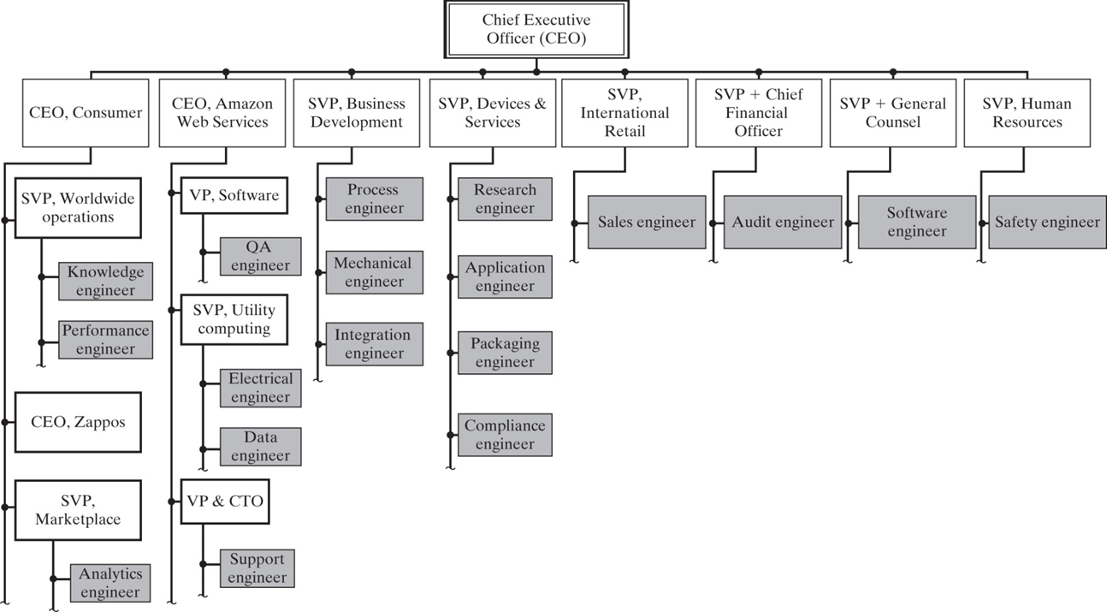
Selection of engineering roles in the organization of Amazon.com

Slide 40
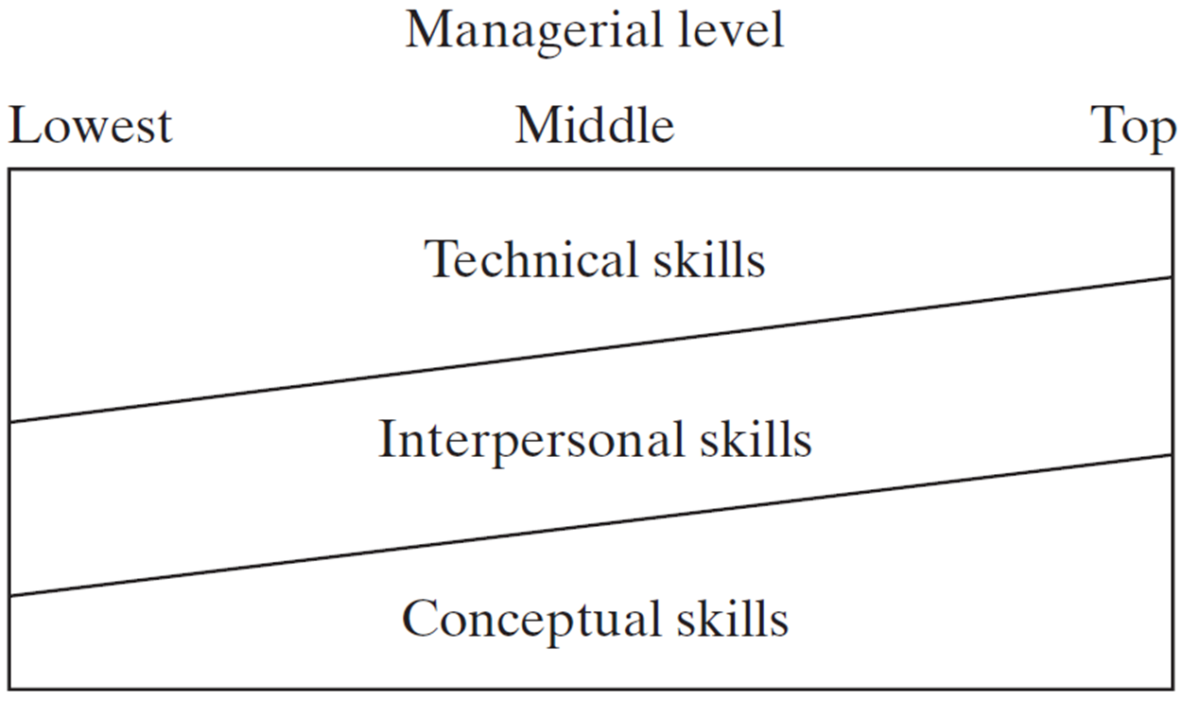
Blend of skills required at various levels

Slide 41
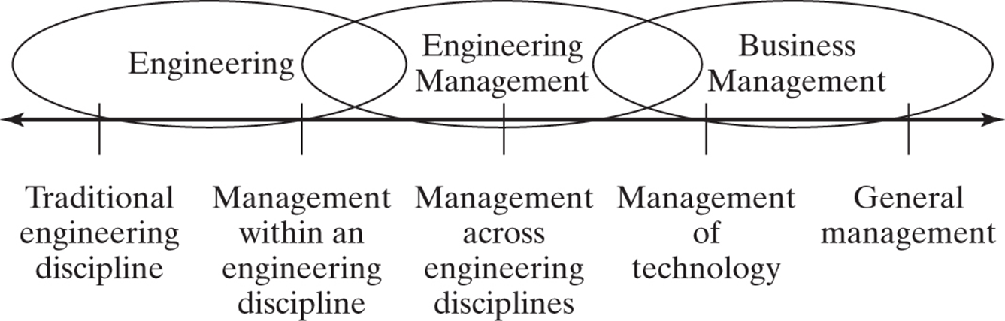
The field of Engineering Management

Slide 42
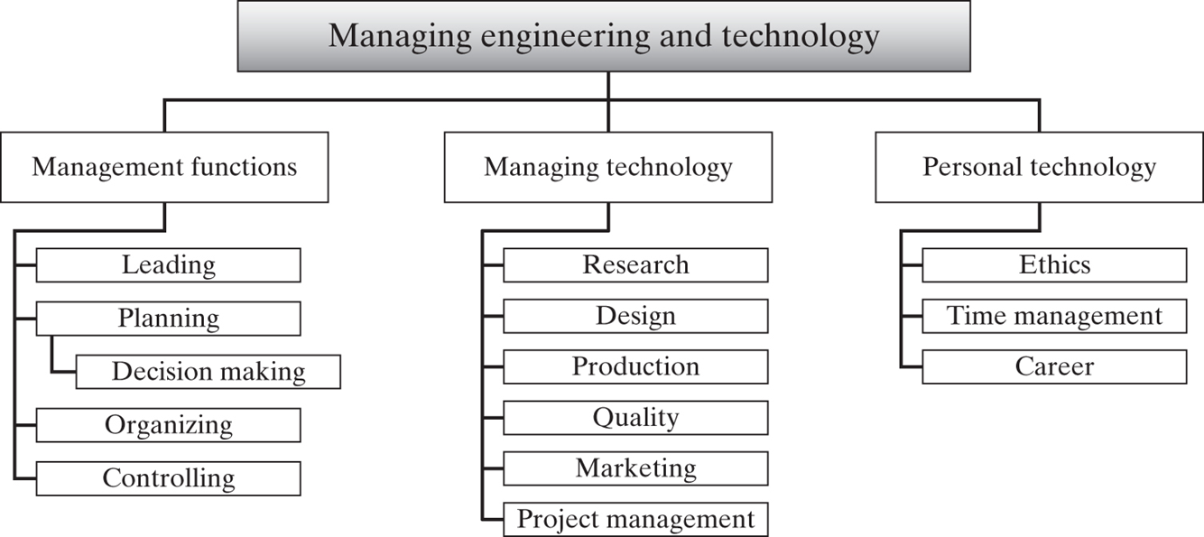

Slide 43
Engineering functions in organizations:
Product development
Operations
IT systems
Quality assurance
Others

Slide 44
Roles and responsibilities of an engineering manager
Leader – Guides and motivates the engineering team toward project and organizational goals.
Planner – Develops strategic plans for product development, resources, and timelines.
Coordinator – Aligns engineering activities with other departments like marketing, design, and production.
Decision Maker – Makes informed technical and managerial decisions for problem-solving.

Slide 45
Roles and responsibilities of an engineering manager
Communicator – Acts as a bridge between technical teams and stakeholders or upper management.
Mentor – Coaches and develops the skills of engineers and technical staff.
Resource Allocator – Manages budgeting, tools, and personnel for effective project execution.
Evaluator – Monitors performance, conducts reviews, and ensures quality output.

Slide 46
Responsibilities of an Engineering Manager
Area | Responsibilities
Team Management | Hiring, training, mentoring, and performance evaluations
Project Oversight | Planning, scheduling, and delivering engineering projects
Technical Guidance | Providing technical support and reviewing solutions/architecture
Process Improvement | Implementing best practices, Agile/Scrum, and quality assurance processes

Slide 47
Responsibilities of an Engineering Manager
Area | Responsibilities
Budgeting | Estimating costs, controlling expenses, and optimizing resources
Stakeholder Communication | Reporting progress, handling feedback, and aligning with business goals
Risk Management | Identifying potential risks and implementing mitigation strategies
Compliance | Ensuring projects meet industry standards, laws, and safety regulations

Slide 48
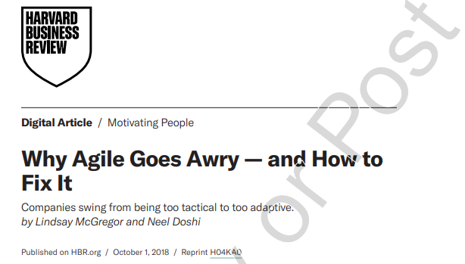
Justify the statements
Software development should be a no-handoff, collaborative process
The team’s unit of delivery should be minimally viable experiments
The team’s approach should be customer centric
Use timeboxes to focus experimentation and avoid waste
The team should be organized to emphasize collaboration
The team should constantly question their process

